Slide 1
Algorithm
UNIT 1

Slide 2
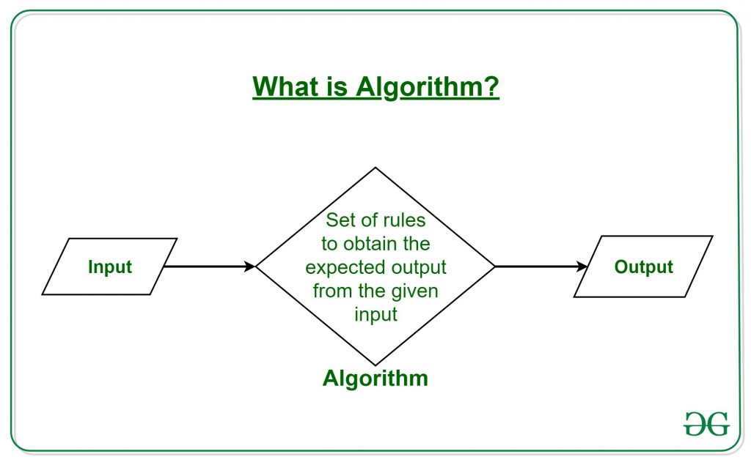
Algorithm

Slide 3
Continue…
The word Algorithm means “a process or set of rules to be followed in calculations or other problem-solving operations”. Therefore Algorithm refers to a set of rules/instructions that step-by-step define how a work is to be executed upon in order to get the expected results.

Slide 4
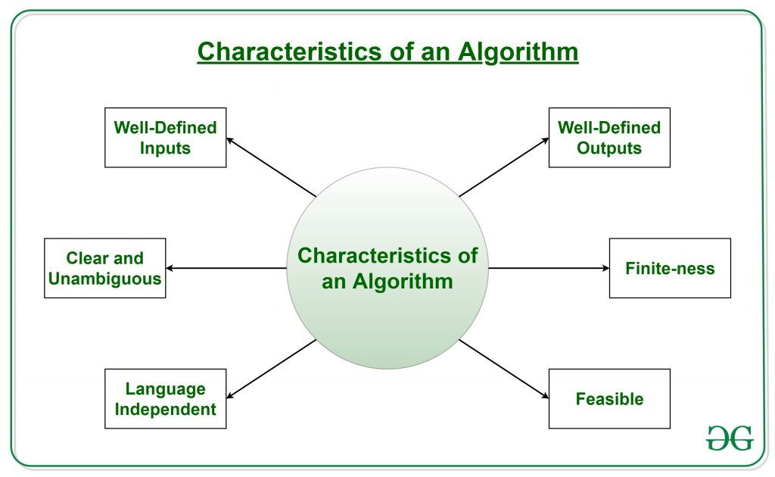
What are the Characteristics of an Algorithm?

Slide 5
Continue…
Clear and Unambiguous: Algorithm should be clear and unambiguous. Each of its steps should be clear in all aspects and must lead to only one meaning.
Well-Defined Inputs: If an algorithm says to take inputs, it should be well-defined inputs.
Well-Defined Outputs: The algorithm must clearly define what output will be yielded and it should be well-defined as well.
Finite-ness: The algorithm must be finite, i.e. it should not end up in an infinite loops or similar.
Feasible: The algorithm must be simple, generic and practical, such that it can be executed upon will the available resources. It must not contain some future technology, or anything.
Language Independent: The Algorithm designed must be language-independent, i.e. it must be just plain instructions that can be implemented in any language, and yet the output will be same, as expected.

Slide 6
Advantages of Algorithms:
It is easy to understand.
Algorithm is a step-wise representation of a solution to a given problem.
In Algorithm the problem is broken down into smaller pieces or steps hence, it is easier for the programmer to convert it into an actual program.

Slide 7
Disadvantages of Algorithms:
Writing an algorithm takes a long time so it is time-consuming.
Branching and Looping statements are difficult to show in Algorithms.

Slide 8
How to Design an Algorithm?
In order to write an algorithm, following things are needed as a pre-requisite:
The problem that is to be solved by this algorithm.
The constraints of the problem that must be considered while solving the problem.
The input to be taken to solve the problem.
The output to be expected when the problem the is solved.
The solution to this problem, in the given constraints.

Slide 9
Algorithm to add 3 numbers and print their sum:
START
Declare 3 integer variables num1, num2 and num3.
Take the three numbers, to be added, as inputs in variables num1, num2, and num3 respectively.
Declare an integer variable sum to store the resultant sum of the 3 numbers.
Add the 3 numbers and store the result in the variable sum.
Print the value of variable sum
END

Slide 10
Find the largest number among three numbers
Step 1: Start
Step 2: Declare variables a,b and c.
Step 3: Read variables a,b and c.
Step 4: If a > b If a > c
Display a is the largest number.
Else Display c is the largest number.
Else If b > c Display b is the largest number.
Else Display c is the greatest number.
Step 5: Stop

Slide 11
FLOWCHART
The flowchart is a diagram which visually presents the flow of data through processing systems. This means by seeing a flow chart one can know the operations performed and the sequence of these operations in a system.
Algorithms are nothing but sequence of steps for solving problems. So a flow chart can be used for representing an algorithm.
A flowchart, will describe the operations (and in what sequence) are required to solve a given problem. You can see a flow chart as a blueprint of a design you have made for solving a problem

Slide 12
Flowchart Symbols
There are 6 basic symbols commonly used in flowcharting of assembly language Programs: Terminal, Process, input/output, Decision, Connector and Predefined Process. This is not a complete list of all the possible flowcharting symbols, it is the ones used most often in the structure of Assembly language programming.

Slide 13
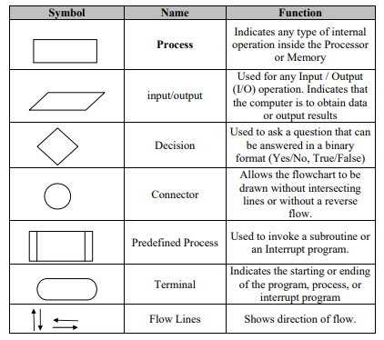
Continue…

Slide 14
General Rules for flowcharting
All boxes of the flowchart are connected with Arrows. (Not lines)
Flowchart symbols have an entry point on the top of the symbol with no other entry points. The exit point for all flowchart symbols is on the bottom except for the Decision symbol.
The Decision symbol has two exit points; these can be on the sides or the bottom and one side.
Generally a flowchart will flow from top to bottom. However, an upward flow can be shown as long as it does not exceed 3 symbols.
Connectors are used to connect breaks in the flowchart. Examples are: • From one page to another page. • From the bottom of the page to the top of the same page. • An upward flow of more then 3 symbols
Subroutines and Interrupt programs have their own and independent flowcharts.
All flow charts start with a Terminal or Predefined Process (for interrupt programs or subroutines) symbol.
All flowcharts end with a terminal or a contentious loop.

Slide 15
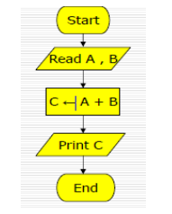
Flowchart for an algorithm which gets two numbers and prints sum of their value

Slide 16
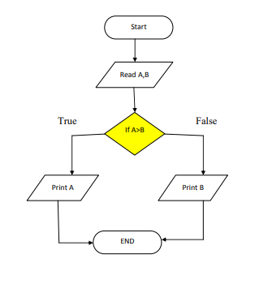
Flowchart for a Algorithm for find the greater number between two numbers.

Slide 17
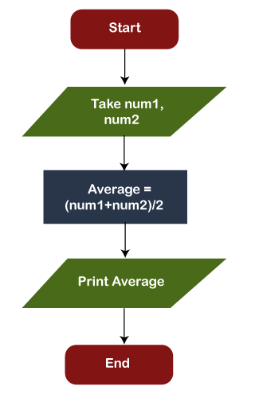
Draw a flowchart to calculate the average of two numbers.

Slide 18
Advantages of using Flowcharts
1) Communication: A Flowchart can be used as a better way of communication of the logic of a system and steps involve in the solution, to all concerned particularly to the client of system.
2) Effective analysis: A flowchart of a problem can be used for effective analysis of the problem.
3) Documentation of Program/System: Program flowcharts are a vital part of a good program documentation. Program document is used for various purposes like knowing the components in the program, complexity of the program etc.
4)Efficient Program Maintenance: Once a program is developed and becomes operational it needs time to time maintenance. With help of flowchart maintenance become easier.
5)Coding of the Program: Any design of solution of a problem is finally converted into computer program. Writing code referring the flowchart of the solution become easy.

Slide 19
Disadvantages of Flowchart
Following are the various disadvantages of flowchart:
Time-consuming: Designing a flowchart is a very time-consuming process.
Complex: It isn't easy to draw a flowchart for large and complex programs.
There is no standard in the flowchart; there is no standard to determine the quantity of detail.
Difficult to modify: It is very difficult to modify the existing flowchart.

Slide 20
Difference between algorithm and flow chart
S.NO | Algorithm | Flowchart
1. | Algorithm is step by step procedure to solve the problem. | Flowchart is a diagram created by different shapes to show the flow of data.
2. | Algorithm is complex to understand. | Flowchart is easy to understand.
3. | In algorithm plain text are used. | In flowchart, symbols/shapes are used.
4. | Algorithm is easy to debug. | Flowchart it is hard to debug.
5. | Algorithm is difficult to construct. | Flowchart is simple to construct.
6. | Algorithm does not follow any rules. | Flowchart follows rules to be constructed.
7. | Algorithm is the pseudo code for the program. | Flowchart is just graphical representation of that logic.

